Slide 1
Apple Stock and Net iPhone Sales
Brandon Kane

Slide 2
Problems to Solve
Has the percentage increase in Apple’s closing stock price from July to October 2020 been larger or smaller than July to October 2019?
Has the percentage increase or decrease in iPhone net sales from June to September 2020 been larger or smaller than June to September 2019?
How much did the stock price increase 1 month before Apple’s iPhone release in 2020 compared to 2019?

Slide 3
Apple’s Stock Percentages July to October 2020 and 2019

Slide 4
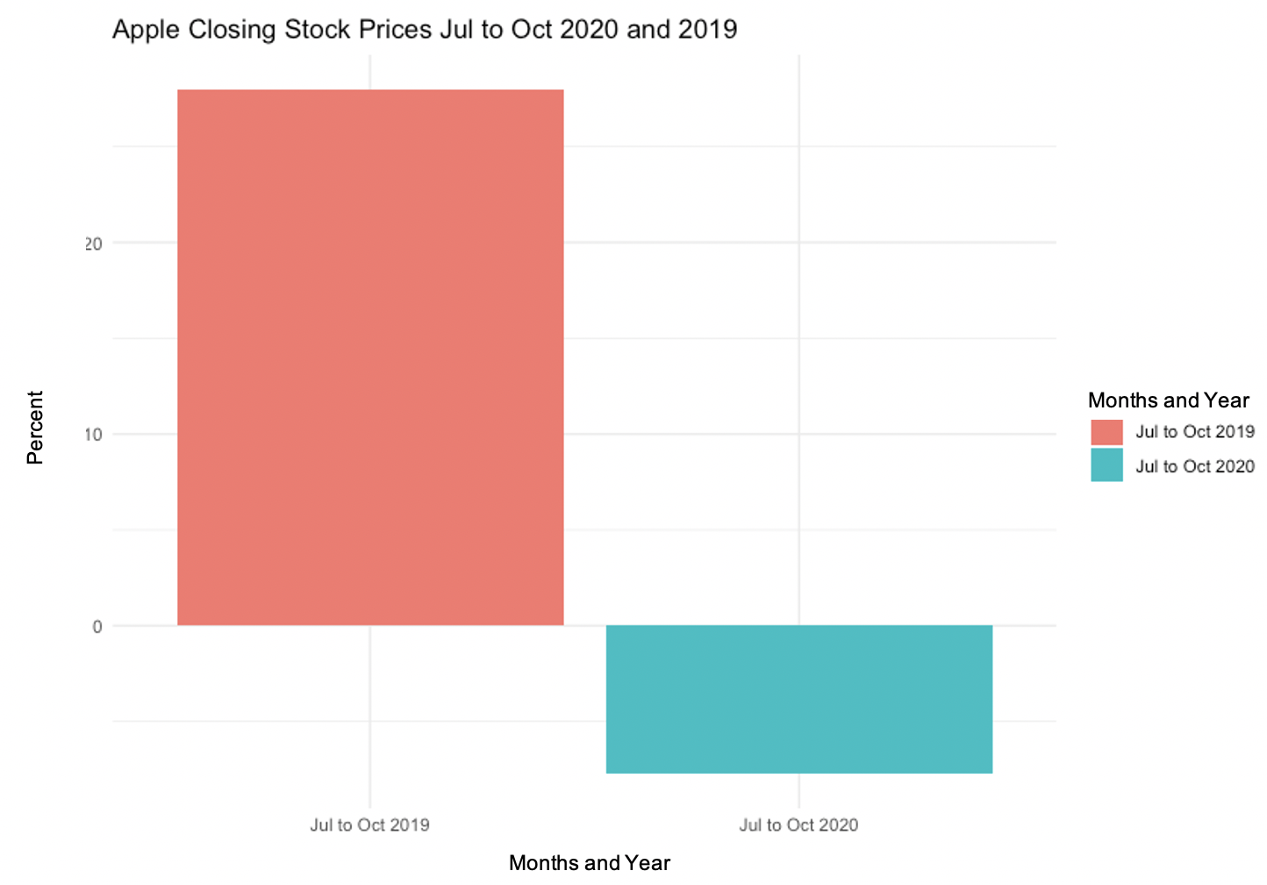

Slide 5
Apple’s Percentage Decrease for Net iPhone Sales June to September 2020 and 2019

Slide 6
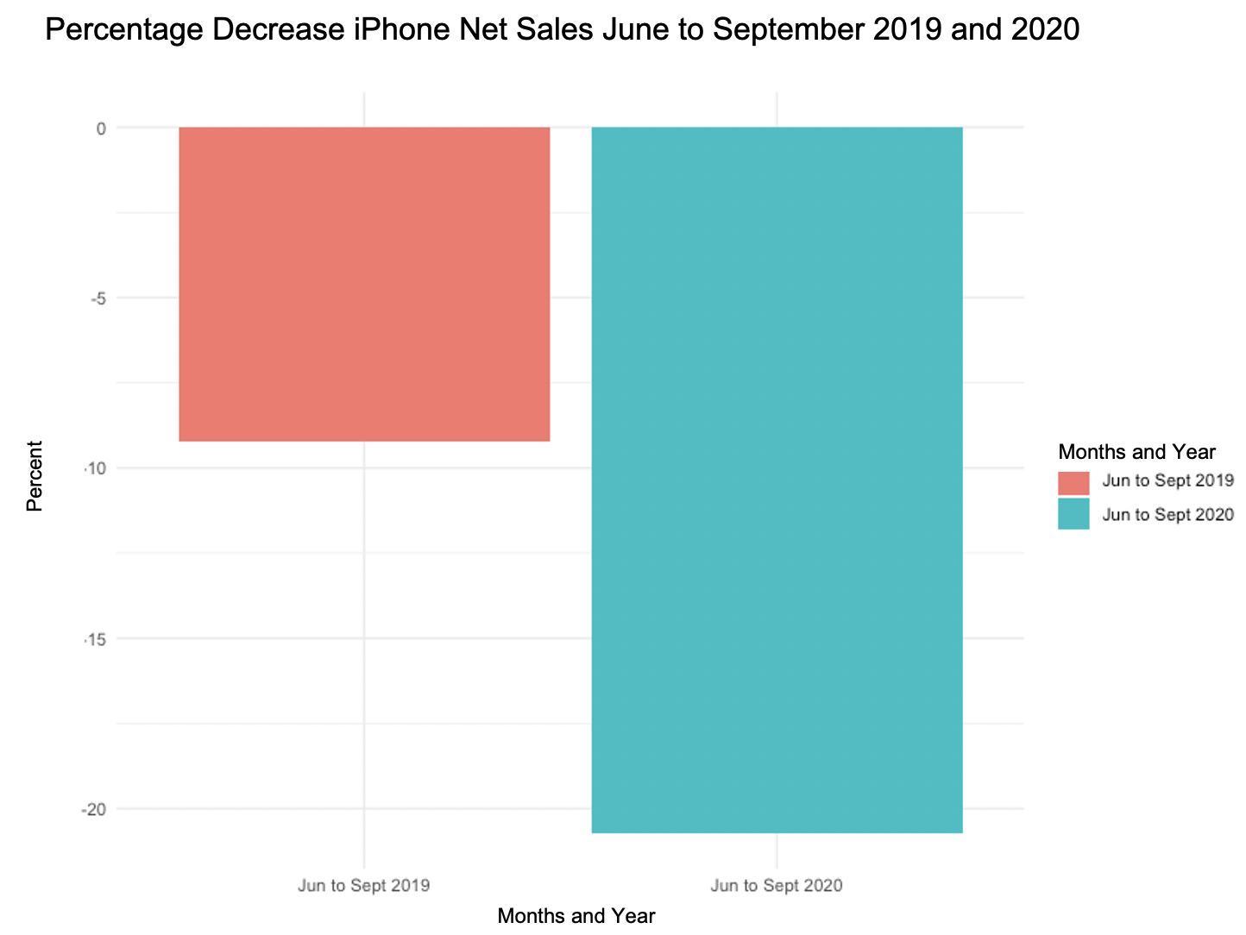

Slide 7
Apple’s Stock Decrease 1 Mos. Before iPhone Release 2020 and 2019

Slide 8
